Slide 1






Introdução à Engenharia de Software
HomeMaid
Simplifying Smart Living, one click at a time!
deti-ies-14.ua.pt
Presented by
ÂNGELA RIBEIRO 109061
HUGO CASTRO 113889
REGINA TAVARES 114129
RITA SILVA 114220

Slide 2

Introdução à Engenharia de Software
Product Concept
Purpose:
Provide homeowners with an intuitive, seamless way to monitor and control their homes.
Core Features:
Add, remove and control devices such as lights, speakers, etc.
User-friendly web platform (desktop & mobile).
Schedule automations.
Account security.
Differentiation:
Compatible with multiple smart device brands.
Future Potential:
Integration with external resources (e.g., Amazon Alexa).
Implement geolocation automation.
Implement alerts.
Implement add/remove room functionality.

Slide 3
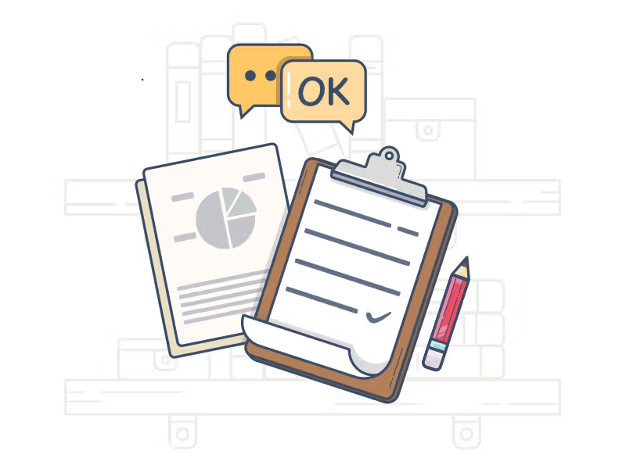
Introdução à Engenharia de Software
As João, I want to check the status of al devices and ambience in my home instantly, ensuring that nothing is left on unintentionally and the atmosphere is perfect. (High)
User Stories
As Catarina, I want to set up an automation to my coffee machine a certain hour to ensure that I save time. (Medium)
As João, I want to be able to delete automations whenever I see t, so I can have better control over my home and adapt to changes in my routines or preferences. (Medium)
As Maria, I want to mark notications as read after reviewing them, so I can keep track of what I’ve already seen. (High)
As João, I want to be able to select which notications I receive about my home, so I can focus on the information that matters most to me. (Medium)
As Catarina, I want to delete notications I no longer need, so I can maintain a clean and organized notication history.(Low)

Slide 4
Introdução à Engenharia de Software
As João, I want to receive notications when devices in my home start or stop, so I can stay informed about their activity and usage. (High)
User Stories
As Maria, I want to log in to my account quickly and securely and be able to add and remove devices to my account, so that I can customize my smart home system as my family’s needs change. (High)
(cont.)
As Catarina, I want to control all the devices in my home from one app, so I don’t waste time switching between different apps. (High)
As Maria, I want to integrate my smart home system with Alexa, so that I can control my home through voice commands when I’m busy with my children. (Low)
As João, I want to see a detailed breakdown of my home's usage trends, so I can identify any spikes or areas where energy is being wasted. (Medium)
As Catarina, I want my account to be secured, so I can ensure that only I have access to control my home automations. (Low)

Slide 5
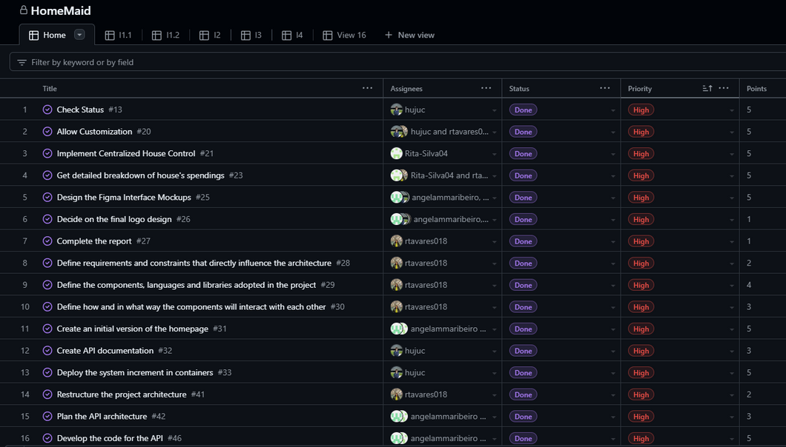
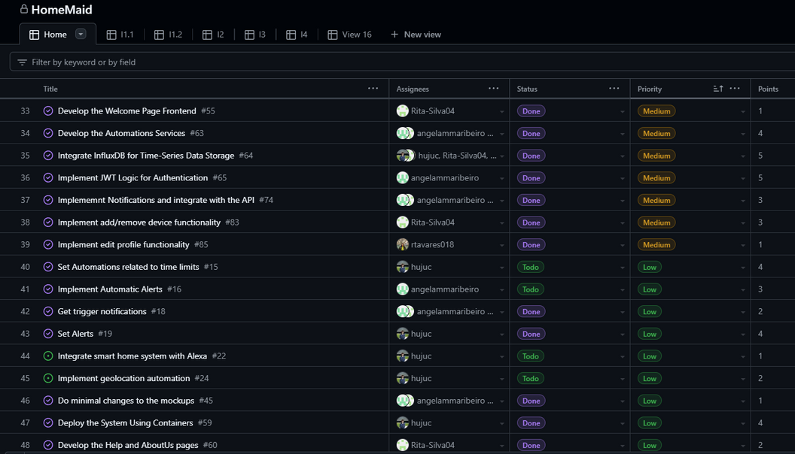
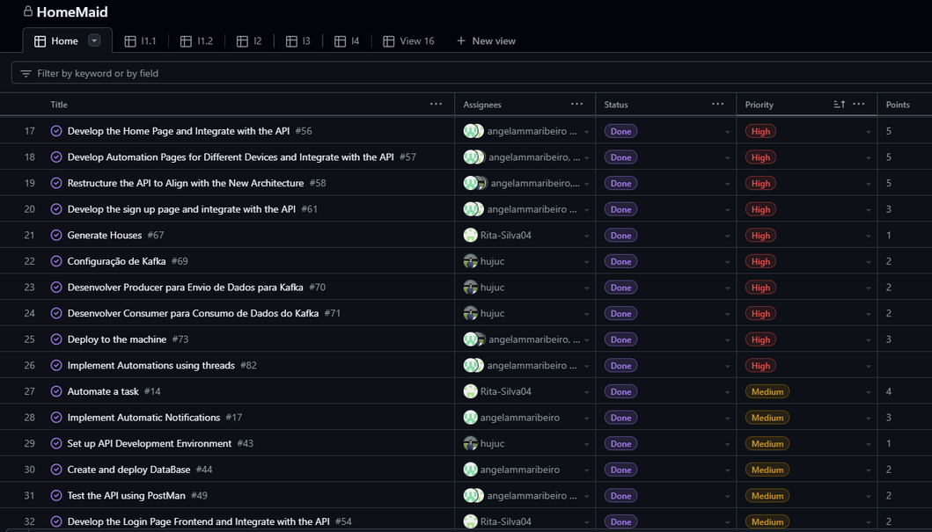
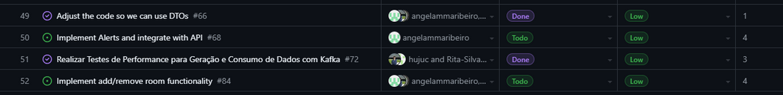
Introdução à Engenharia de Software
Backlog

Slide 6
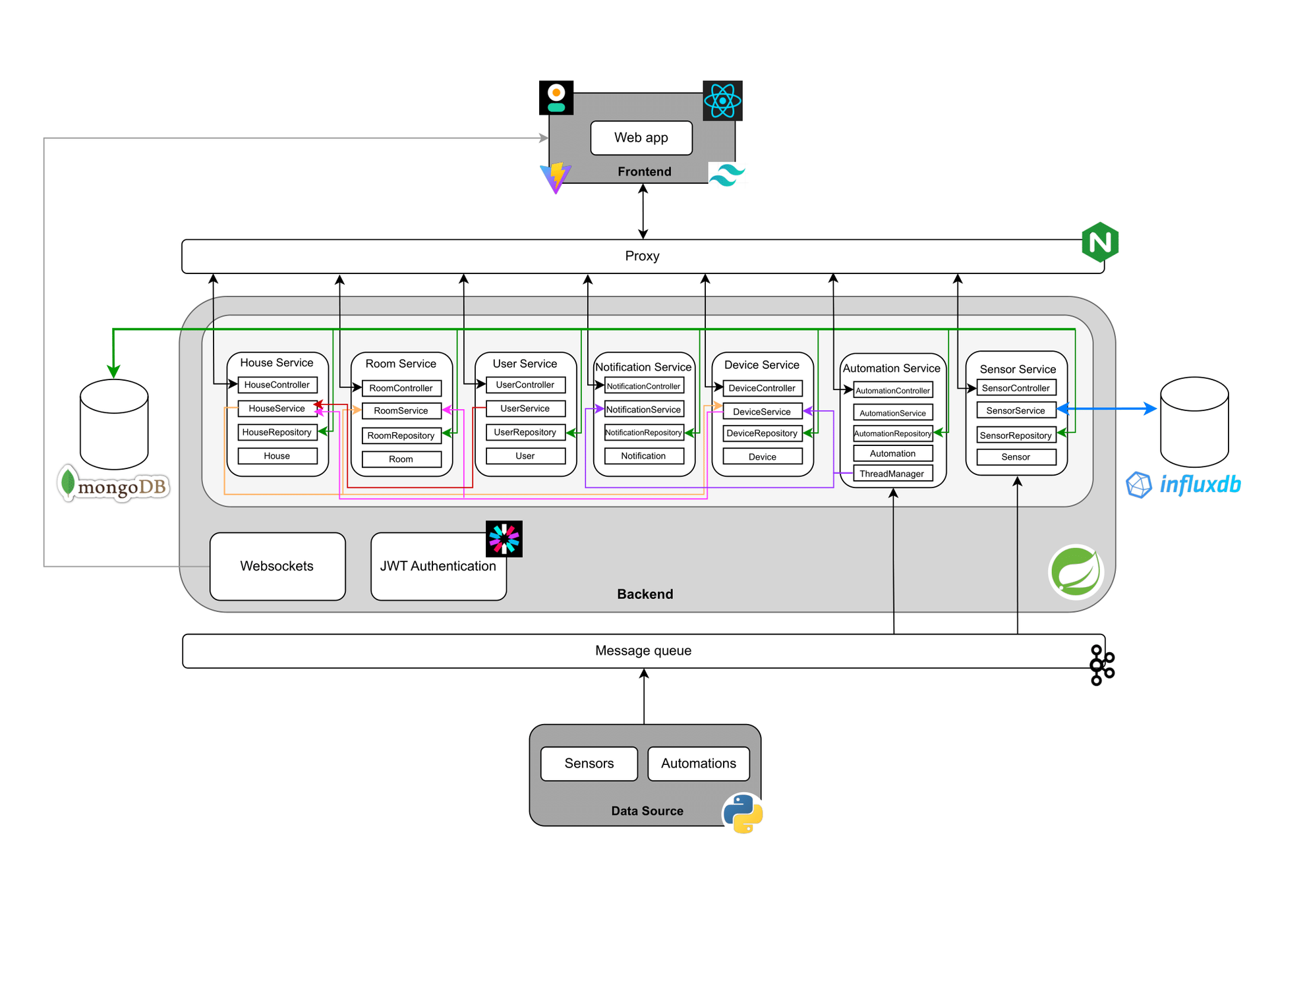
Introdução à Engenharia de Software
Architecture

Slide 7
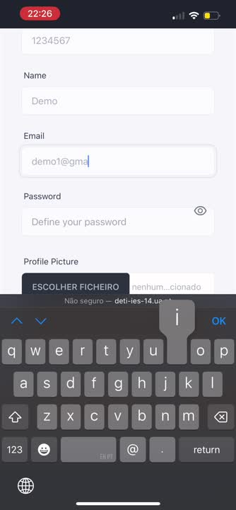
Introdução à Engenharia de Software
Demo

